Slide 1
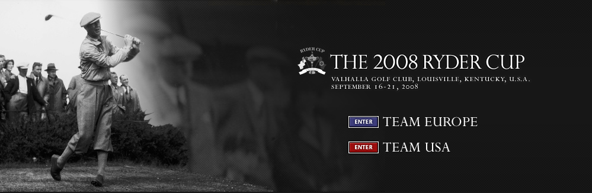


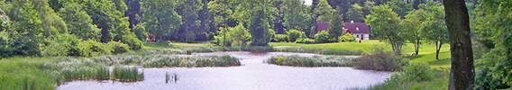
RHYDER CUP
THE 6th RHYDER CUP 2012
SKJOLDNÆSHOLM GOLF CLUB, ZEALAND, DENMARK
AUGUST 10-11, 2012
TEAM JUTLAND
TEAM COPENHAGEN

Slide 2
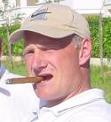
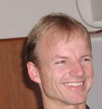
TEAM JUTLAND
TEAM COPENHAGEN
Captain : Klaus Lorentzen
Player 2 : Peter Lorentzen
Player 3 : Mogens H. Sørensen
Player 4 : Søren Dahl
Player 5 : Anders Dahl-Nielsen
Player 6 : Anders Juhl Hansen
Player 7 : Stehen Lundhild
Player 8 : Henrik Mortensen
Player 9 : Johan Balle
Player 10 : Peter Clausen
Captain : Lars Dalgaard Andersen
Player 2 : Stephen Jespersen
Player 3 : Lars Agerlin
Player 4 : Peter Møller
Player 5 : Peter Hauskov
Player 6 : Brian Christensen
Player 7 : Steen K. Jensen
Player 8 : Ole Hauskov
Player 9 : Martin D. Thomsen
Player 10 : Thomas O. Larsen
Friday, August 10, 2012
07:30 Welcome (@club house)
Old Course
08:30 Tee off – Four ball matches (gun start)
Trent Jones, Jr.
14:00 Tee off – Best ball matches
20:00 Dinner and 1st day awards
Saturday, August 11, 2012
07:30 Breakfast
Trent Jones, Jr.
09:00 Tee off – Single matches (gun start)
14:00 Prize Ceremony

Slide 3

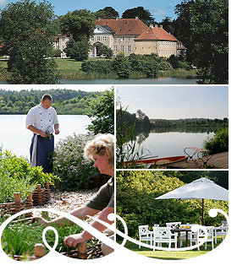
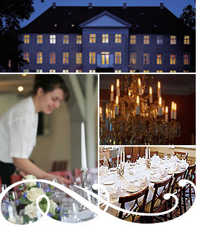
Skjoldnæsholm Gods

